Slide 1
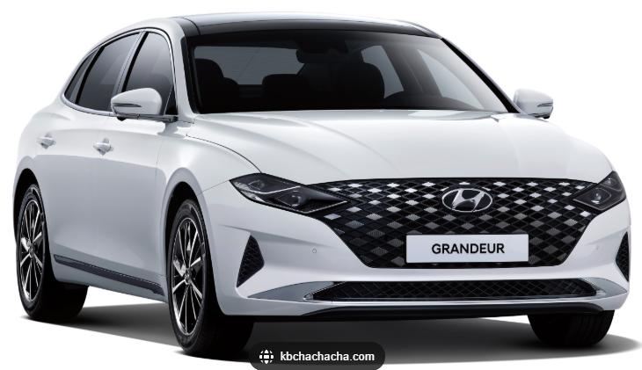

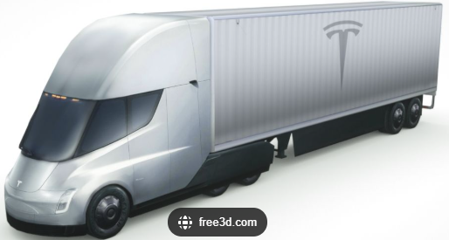
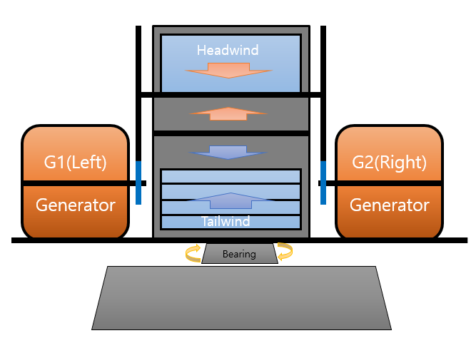
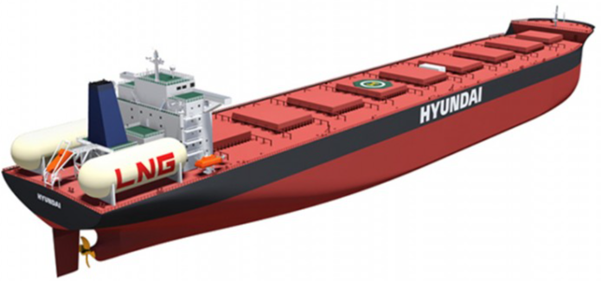
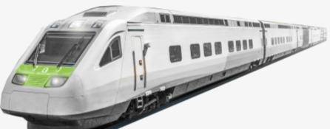

Wind energy scales with the cube of wind speed, and when efficiently harnessed,
It can enable a future of mobility that requires no external charging beyond self-generation.
The system captures frontal airflow for centrifugal
power generation and controlled exhaust to
minimize drag, with a single central turbine and
Symmetrically positioned side generators provide
stable, tip-free operation.
Multi-Stage Compressed Dual-Flow
Wind Turbine Generator
(Single-Turbine Dual-Generator System)

Slide 2

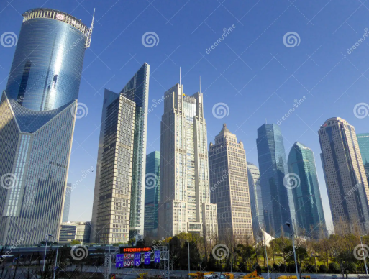
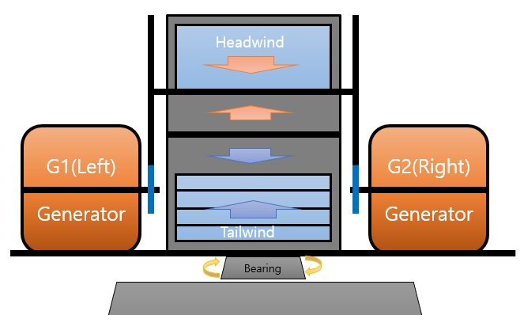


It can be installed on the roof of a building as it eliminates vibration and noise.
Roadsides will no longer require utility poles or overhead power lines.
Battery charging
delivery station.
(Rechargeable Battery Delivery)

Slide 3
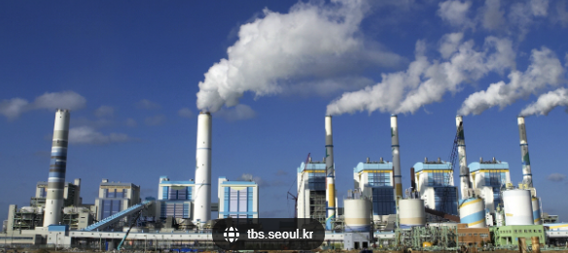
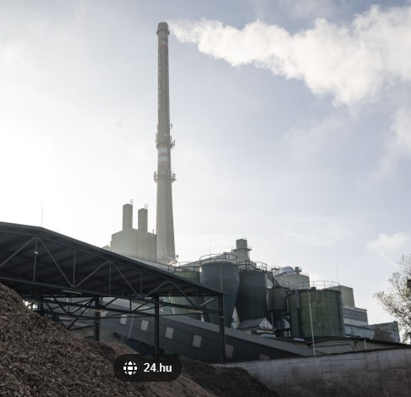
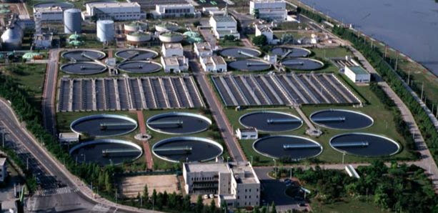
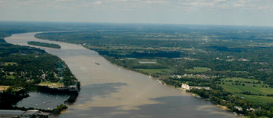
Thermal power plant
Incineration plant
All-purpose turbine generator for wind,
hydropower, and thermal power applications.
The universal turbine generator enables
a new era of water reuse.
This is a multi-purpose turbine generator
applicable to wind, in-stream hydropower,
tidal energy, and thermal steam systems,
enabling simultaneous power generation,
seawater desalination, waste-heat utilization,
and wastewater treatment with water reuse.
Wastewater treatment plant
The Mississippi River

Slide 4
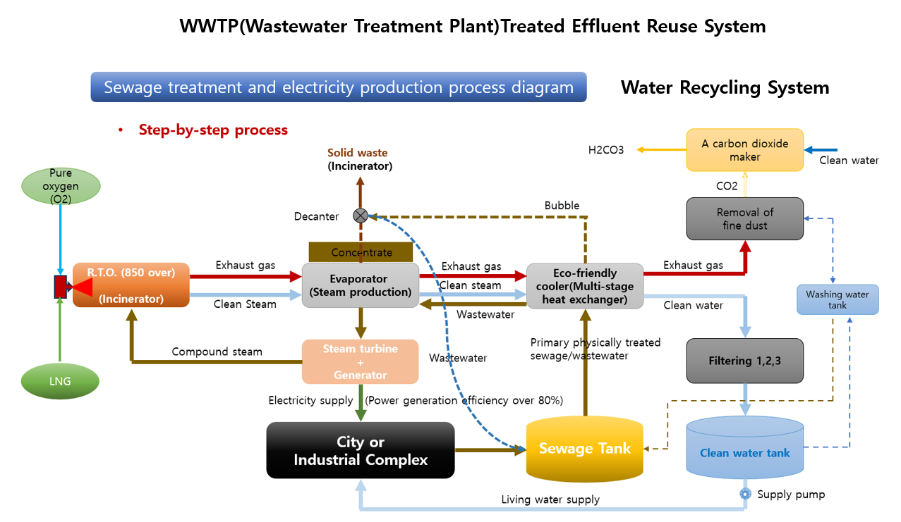

Slide 5
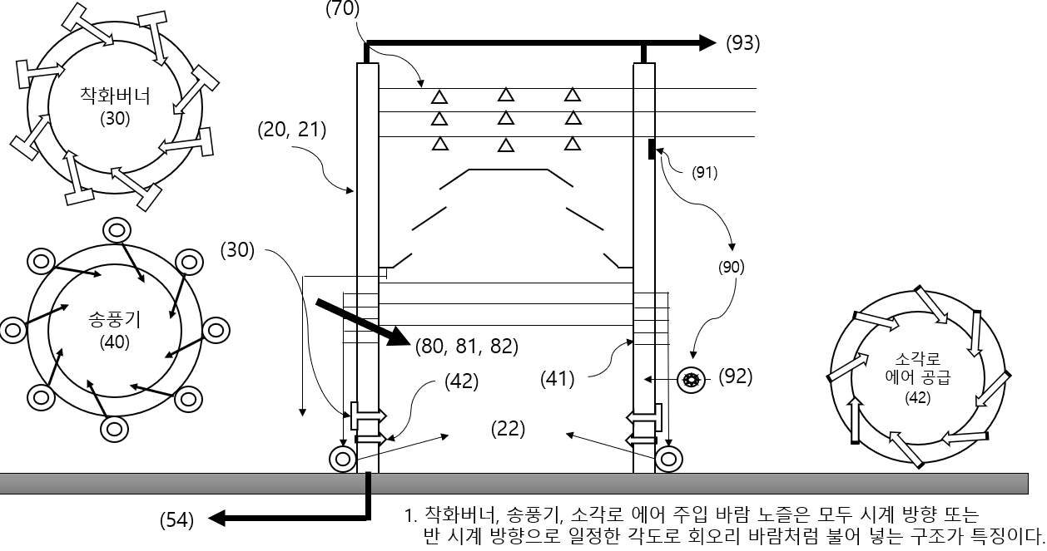
Complete Combustion Incinerator
A future-oriented, complete combustion incinerator that processes all types of waste without separation,
incinerating them at temperatures above 2,500 °C. After combustion, only inorganic materials such as iron,
glass, and stone remain for recycling, while the system simultaneously generates electricity
and desalinated freshwater from seawater.

Slide 6
Future-Oriented Carbon Emission Reduction System
A carbon emission reduction system in which chimneys are designed to be low and wide
to enhance particulate matter removal. After fine dust is removed, only carbon dioxide is released.
The CO₂ is then captured, diluted with water to produce carbonated water, and reused according to
to application needs, such as those in agricultural water management.

Slide 7
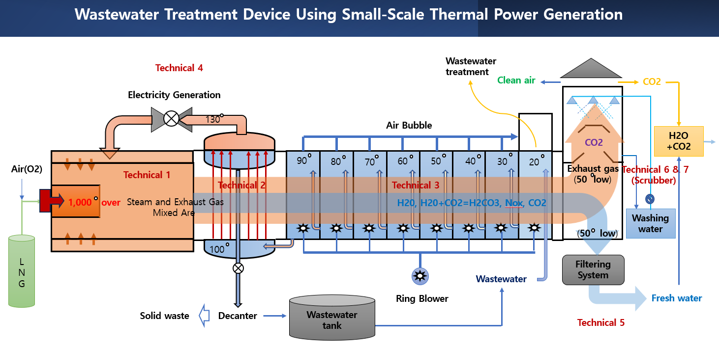

Slide 8
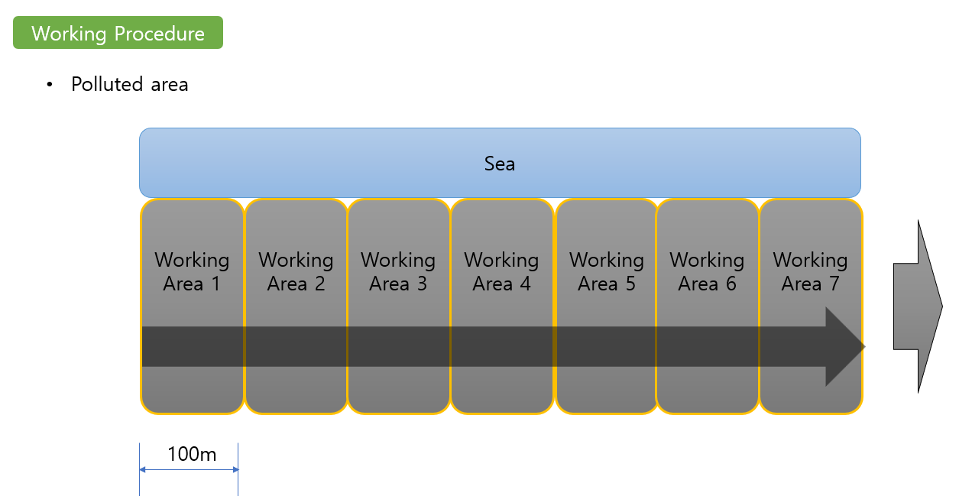
Soil and Marine Pollution Remediation System
A New Method
Process Flow
A Old Method
This project proposes the remediation of large-scale soil and marine contamination
using equipment-operated hot-water circulation systems, without direct human involvement.

Slide 9
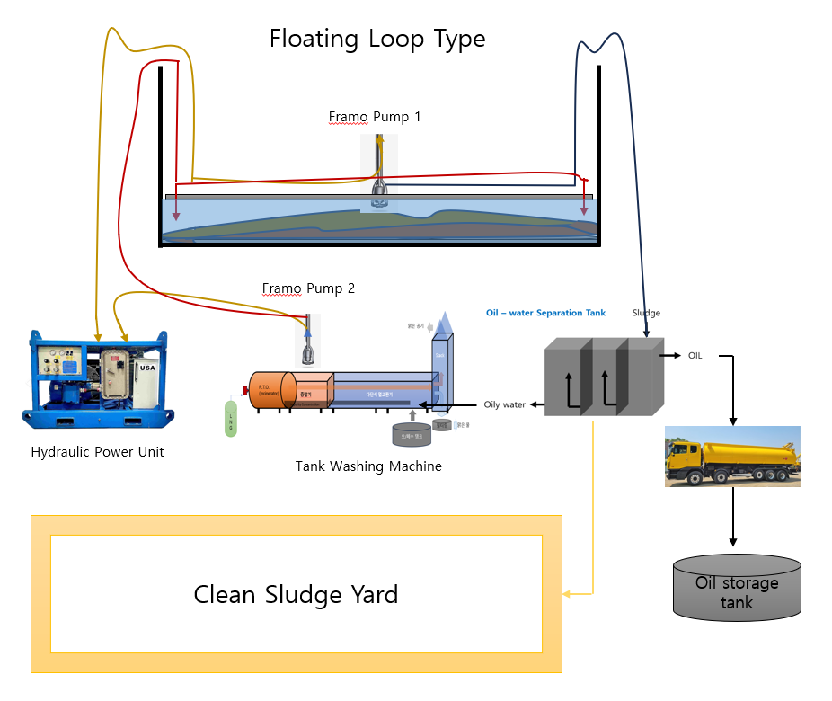
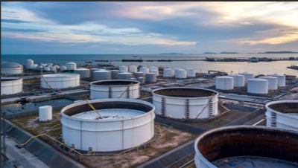
Non-entry crude oil storage tank cleaning
A non-entry, automated cleaning process for crude oil storage tanks using a hot-water recycling system,
without the use of robotic equipment, thereby eliminating the need for human access to confined spaces.

Slide 10
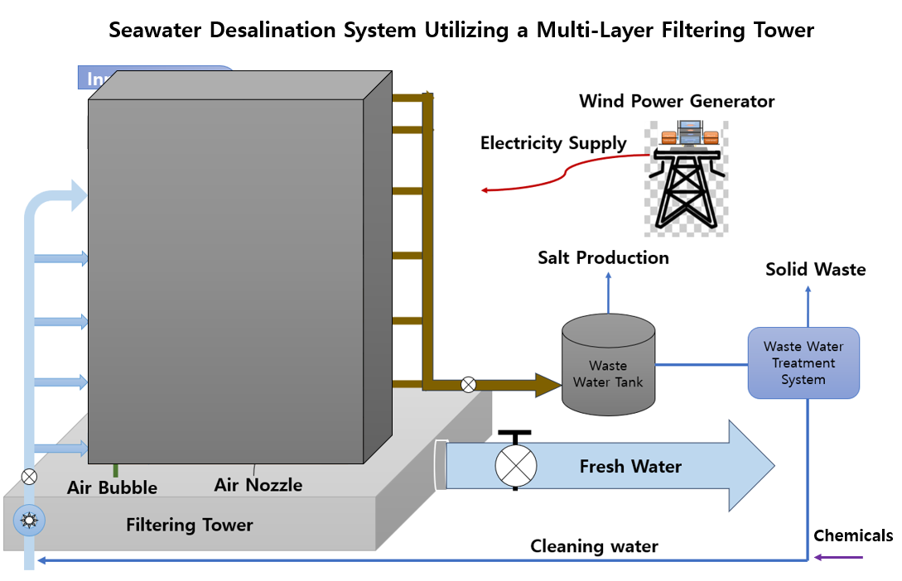
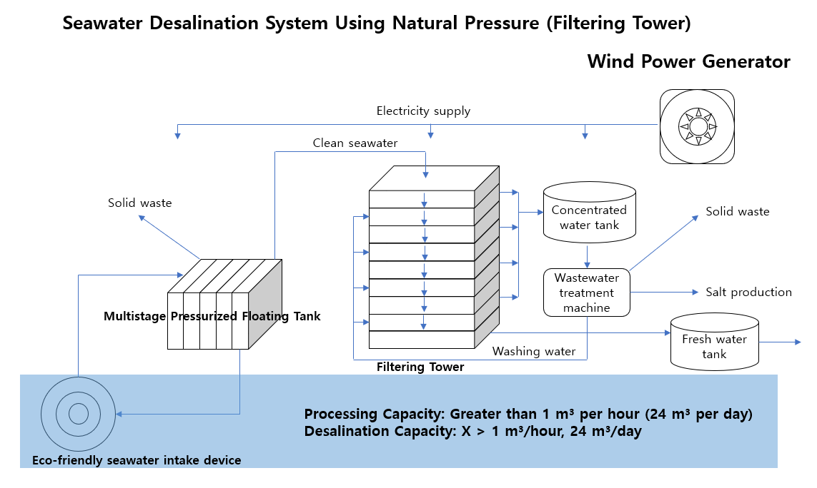
Seawater Desalination System Using a Gravity-Driven Natural Filtration Tower
(XPRIZE Water Scarcity Competition – Track B Qualified Team)
Seawater is converted into freshwater by passing it through an artificially engineered material layer that
absorbs salinity, and the material layer is continuously regenerated through periodic washing for repeated use.

Slide 11
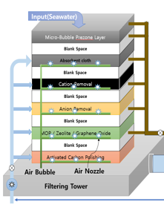
Post-War and Post-Disaster Reconstruction and Future-Oriented New City Development Project
Potable Water Supply
New city or Industrial complex
Sewage
Water Recycling and Reuse System
Wastewater
Make-up Water
from Rivers, Streams,
and Rainwater
Electricity Supply
Waste solid
Natural Filtration
Tower System
CCI
Complete Combustion Incinerator
WWTP
(Wastewater treatment plant)
Wastewater
Waste solid
(Inorganic materials such as iron, glass, and stone)

Slide 12

Some of our technologies are fully developed, while others are still under development.
We warmly welcome anyone who is willing to share and advance our technologies in the pursuit of improving the global environment.
Please feel free to contact us at any time. Thank you.

